Slide 1


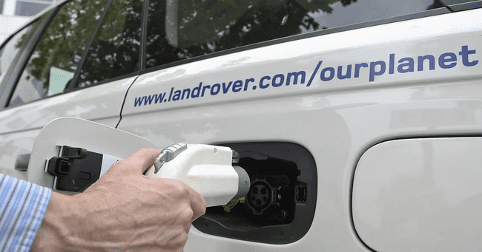
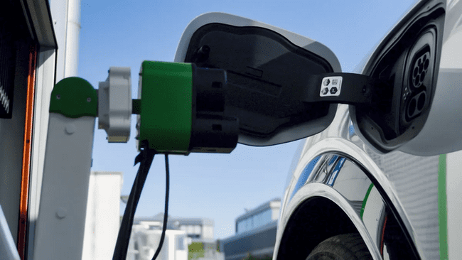

INTER IIT Tech Meet 11.0
The Robotic Charging Challenge
An innovative attempt to boost performance

Slide 2
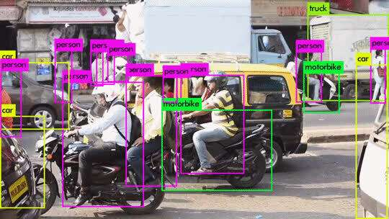
Computer Vision Aid
Charging Plug Location Detection
Why Computer Vision?
With the current advent of Machine Learning, Object Detection has become really easy with the help of State of the art Models.
Cameras have become relatively cheap and work as universal sensors.
Computer Vision and deep learning algorithms provide high accuracy and can be made robust to different lighting and environment conditions.
Briefing
Briefing
Innovative design
Innovative design
MATLAB Simulation
MATLAB Simulation
Bill of Material
Bill of Material
Computer Vision Aid
Computer Vision Aid
Power COnsumption
Power COnsumption
Conclusion
Briefing
Innovative design
MATLAB Simulation
Bill of Material
Computer Vision Aid
Power COnsumption
Conclusion
Conclusion

Slide 3
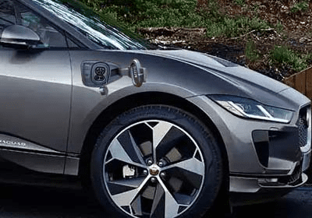
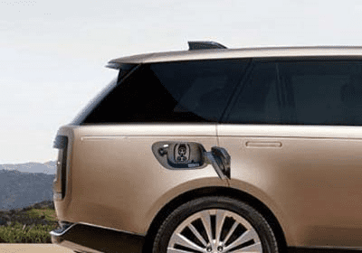
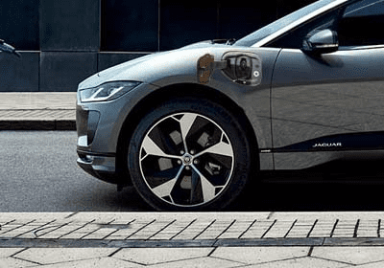
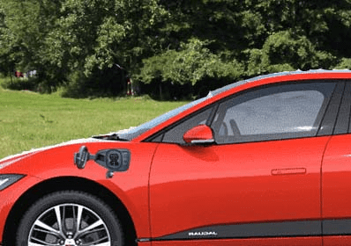
Object Detection | YOLO v7
Raw Dataset:
We used YOLO v7: the fastest and most accurate real-time object detection model for detecting CCS1 and CCS2 5 charging plugs
Training Set: Collected hundreds of Jaguar Car images(side view) along with CCS1 and CCS2 charging sockets images and edited their combinations to prepare a dataset of 272 images.
Briefing
Innovative design
MATLAB Simulation
Bill of Material
Computer Vision Aid
Power COnsumption
Conclusion

Slide 4
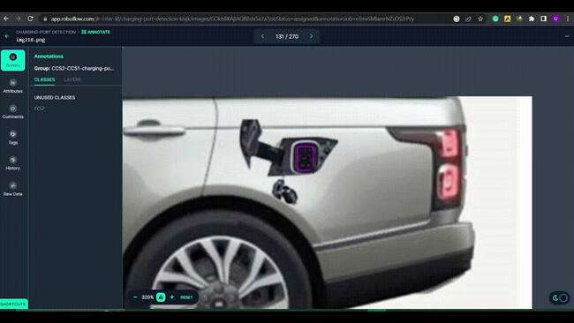
Dataset Annotation and export were done with the help of roboflow.
Briefing
Innovative design
MATLAB Simulation
Bill of Material
Computer Vision Aid
Power COnsumption
Conclusion

Slide 5
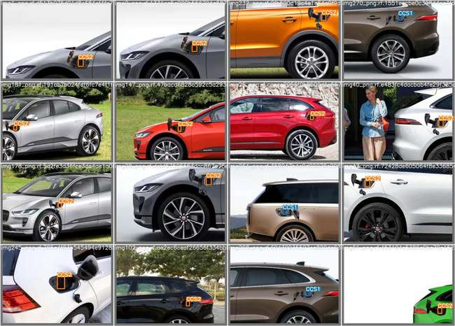
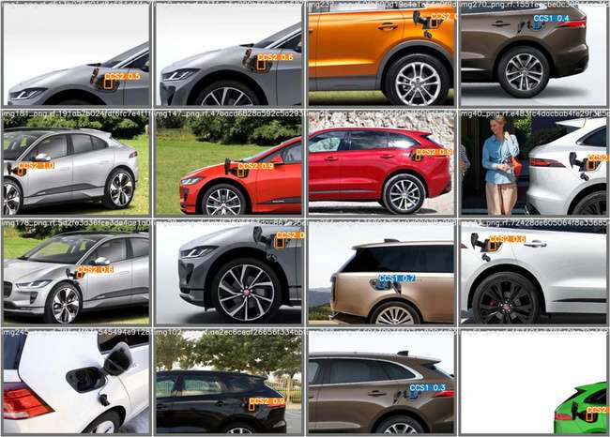
After training on YOLO v7 for 70 epochs, we got the following results
Test batch-Labels
Test batch-Predictions
Briefing
Innovative design
MATLAB Simulation
Bill of Material
Computer Vision Aid
Power Consumption
Conclusion

Slide 6
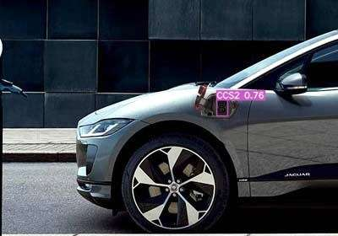
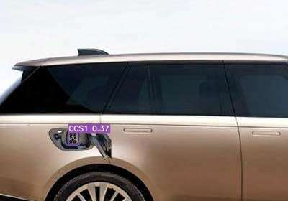
Results Continued...
Briefing
Innovative design
MATLAB Simulation
Bill of Material
Computer Vision Aid
Power COnsumption
Conclusion

Slide 7
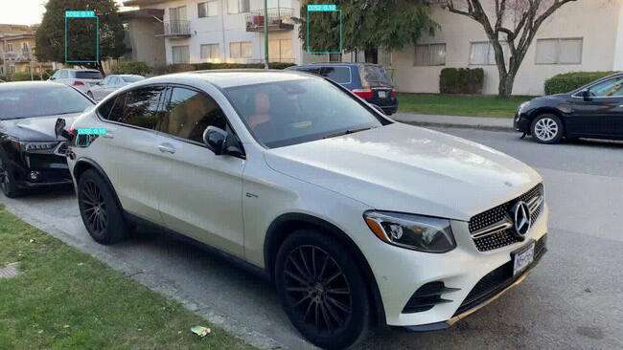
Results Continued...
Briefing
Innovative design
MATLAB Simulation
Bill of Material
Computer Vision Aid
Power Consumption
Conclusion

Slide 8
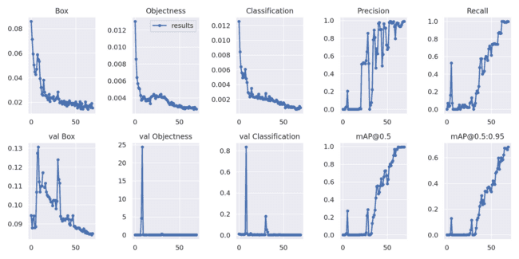
Results Continued...
Briefing
Innovative design
MATLAB Simulation
Bill of Material
Computer Vision Aid
Power Consumption
Conclusion

Slide 9
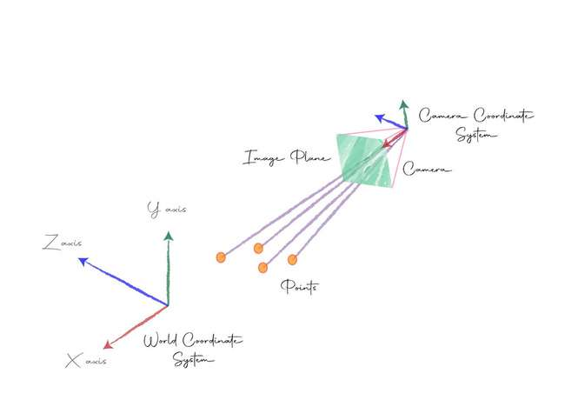
Now, YOLO v7 returns the coordinates of 4 corners of the bounding box [x1, y1, x2, y2, x3, y3, x4, y4, class]
We find centre coordinates X = (x1 + x2 + x3 + x4)/4 , Y = (y1 + y2 + y3 + y4)/4
Then Coordinates transformation is applied on (X, Y) to get back the real (Xreal, Yreal) that the end effector has to reach.
Briefing
Innovative design
MATLAB Simulation
Bill of Material
Computer Vision Aid
Power Consumption
Conclusion

Slide 10
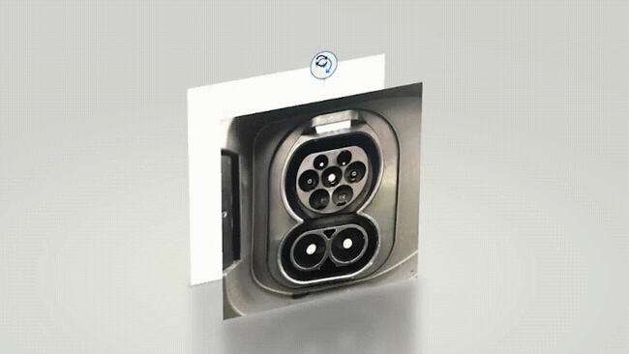
Now, End effector has reached in front of the socket, we carry forward with the latching procedure.
This poses one challenge:
The socket may be tilted along any axis (x, y, z)
Briefing
Innovative design
MATLAB Simulation
Bill of Material
Computer Vision Aid
Power Consumption
Conclusion

Slide 11
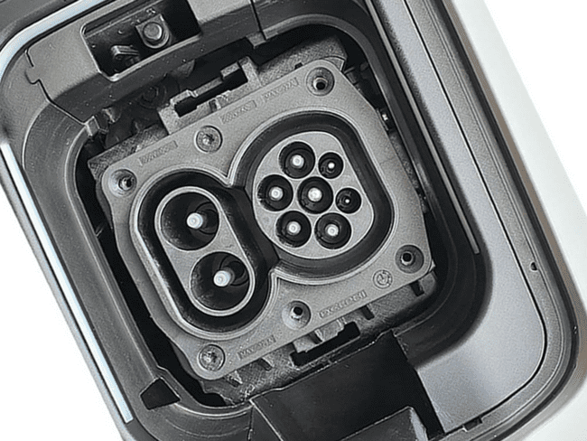
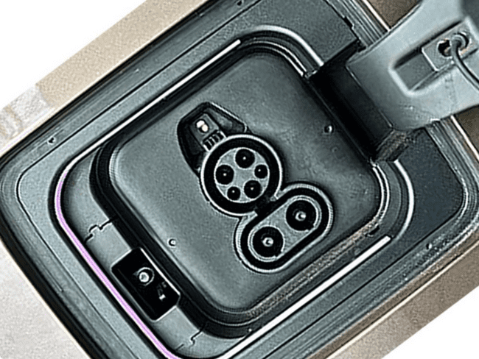
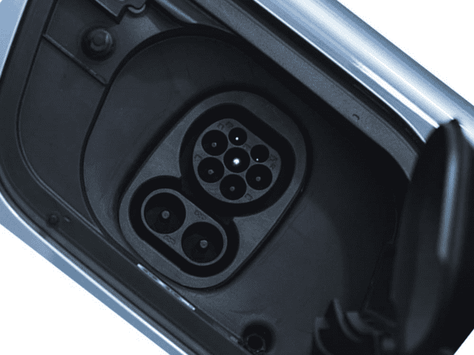
Tackling Challenge
Rotated around Z-axis:
We gave a simple approach to this problem. We created some hundreds of datasets of CCS1 and CCS2 ports rotated along z-axis at different angles and trained it on a CNN Network - VGG-16. We achieved a decent accuracy of 84% on the test set.
Briefing
Innovative design
MATLAB Simulation
Bill of Material
Computer Vision Aid
Power Consumption
Conclusion

Slide 12
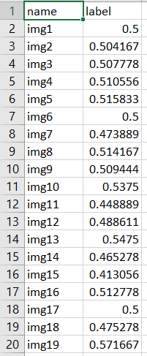
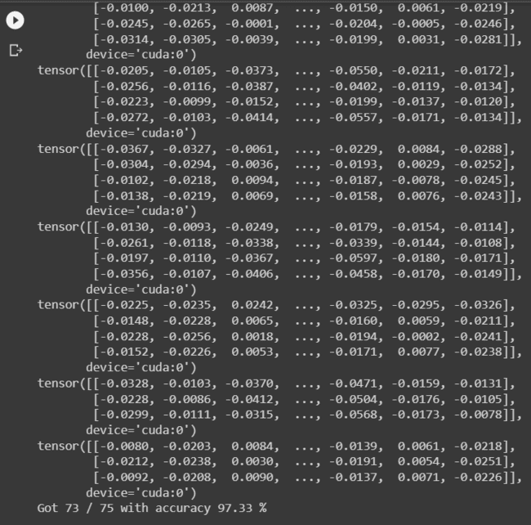
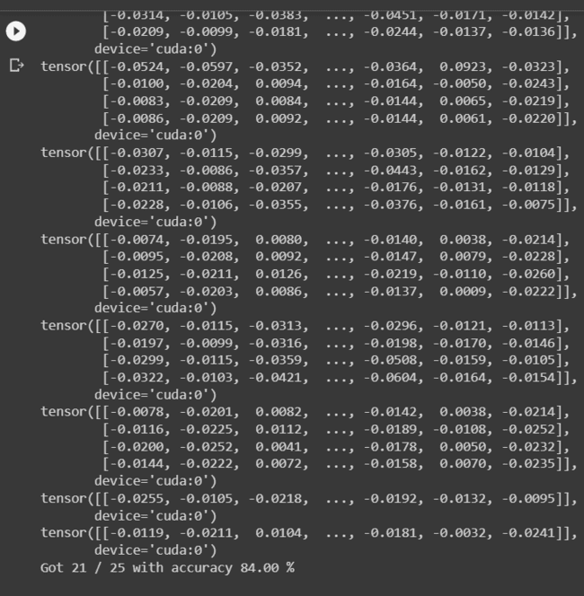
Training set Accuracy: 97.33%
Test set Accuracy: 84%
Annotations
Briefing
Innovative design
MATLAB Simulation
Bill of Material
Computer Vision Aid
Power Consumption
Conclusion

Slide 13
Rotated around X, Y axis:
A very simple approach to this problem could be using an RGBD camera. But that poses two challenges:
The cost of production will go high as RGBD cameras are expensive.
Mounting it on the wire or the end effector would be a challenging task.
Our Approach: Monocular Depth Estimation
It can be implemented with the help of a simple RGB camera.
Monocular Depth Estimation is the task of estimating the depth value (distance relative to the camera) of each pixel given a single (monocular) RGB image.
Briefing
Innovative design
MATLAB Simulation
Bill of Material
Computer Vision Aid
Power Consumption
Conclusion

Slide 14
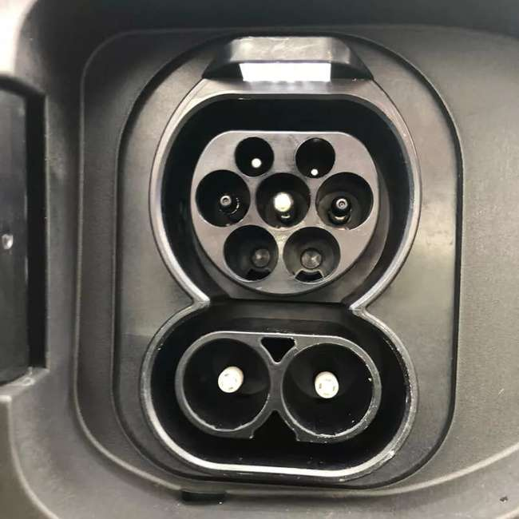
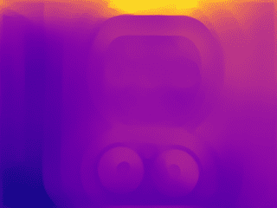
Applying Monocular Dept Estimation on plugs..
===>
Briefing
Innovative design
MATLAB Simulation
Bill of Material
Computer Vision Aid
Power Consumption
Conclusion

Slide 15
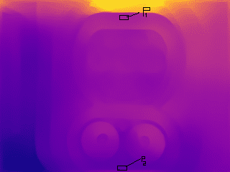
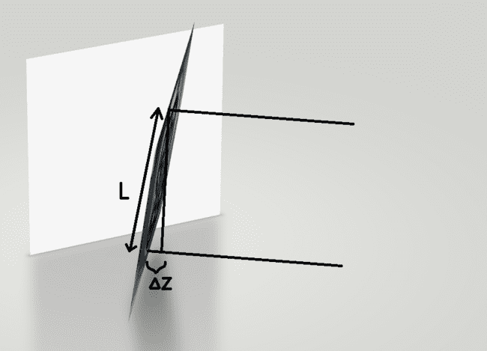
The value difference between the pixels of the top and bottom can be used to calculate Δz which when divided by bounding box length (transformed) will give the angle by which the End effector should rotate along the x-axis.
Briefing
Innovative design
MATLAB Simulation
Bill of Material
Computer Vision Aid
Power Consumption
Conclusion

Slide 16
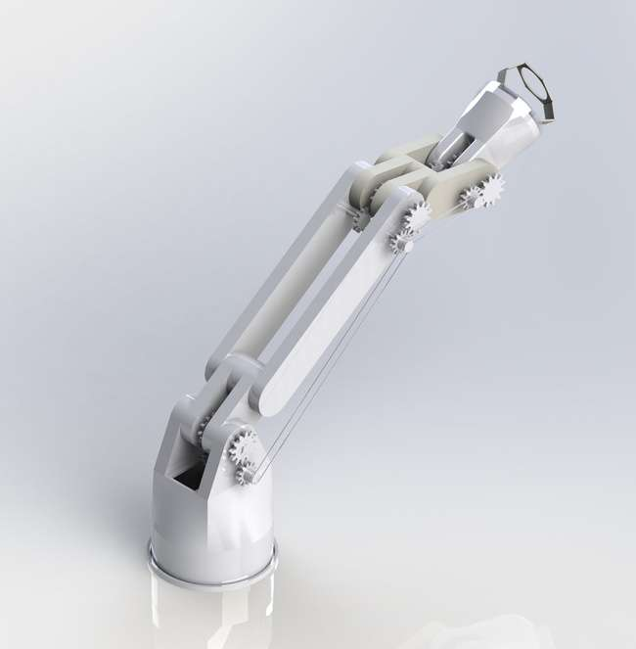
Conclusion
Hence, we propose an end-to-end solution to the problem with innovative design and robust vision algorithms.
By integrating all the proposed components, we can achieve autonomous charging for the given workspace range.
Briefing
Innovative design
MATLAB Simulation
Bill of Material
Computer Vision Aid
Power Consumption
Conclusion

